Slide 1
IBM University Engagement Project
Submission
”Strengthening Cybersecurity: Autonomous Threat Detection”

Slide 2

Project Tile – [NIDS]
Domain of Project – [Machine learning ]
Student Name | Recent Passport Photo | Email ID | Mobile number [WhatsApp]
Prathmesh kadam |  | prathmeshkadam883@gmail.com | 9607116077

Slide 3
Electronics and Telecommunications Engineering: (Machine learning project)
Problem statement No.40 - Network Intrusion Detection
The Challenge:
Create a robust network intrusion detection system (NIDS) using machine learning. The system should be capable of analyzing network traffic data to identify and classify various types of cyber-attacks (e.g., DoS, Probe, R2L, U2R) and distinguish them from normal network activity. The goal is to build a model that can effectively secure communication networks by providing an early warning of malicious activities.
Kaggle dataset link — https://www.kaggle.com/datasets/sampadab17/network-intrusion-detection Technology — Use of IBM cloud lite services is mandatory.

Slide 4
Technology Used
IBM Cloud: Provides the scalable infrastructure necessary to host machine learning models securely.
IBM watsonx.ai: The core studio platform utilized for building, training, and deploying the machine learning models.
Python: The primary programming language used for data manipulation and scripting.
Scikit-Learn: The foundational machine learning library used to train the classification algorithms (e.g., Random Forest, SVM).
Pandas & NumPy: Used extensively for data preprocessing, feature extraction, and handling the Kaggle dataset.

Slide 5
Proposed Solution: NIDS
The proposed solution is a machine learning-based Network Intrusion Detection System built on IBM watsonx. It addresses the challenge of identifying network attacks by establishing a baseline of normal behavior and categorizing anomalies.
Data Preprocessing: The NSL-KDD dataset is ingested and cleaned. Categorical features (like protocoI_type) are encoded, and numerical features are scaled for optimal model performance.
Model Training: A multiclass classification model is trained on IBM watsonx.ai to recognize patterns belonging to Normal traffic, DoS, Probe, R2L, and U2R attacks.
Real-Time Inference: The trained model is deployed as an API endpoint. Incoming network packet features are sent via JSON to the model, which instantly returns a threat classification.
Proactive Security: By utilizing ML instead of traditional signature-based rules, the system can detect unknown or "zero-day" threats based on statistical deviations in network behavior.

Slide 6
Components Required
IBM Cloud Object Storage: Required to securely store the raw NSL-KDD dataset and the processed training data.
IBM Watson Machine Learning Instance: The compute environment required to run the model training algorithms and host the deployment.
Jupyter Notebooks: Used within watsonx.ai for exploratory data analysis (EDA), feature engineering, and model evaluation code.
Network Traffic Dataset (NSL-KDD): The historical dataset containing labeled examples of normal and malicious network connections required for supervised learning.
REST API Client (e.g., Postman I Python requests): Required to send test payloads to the deployed model and receive prediction responses.

Slide 7
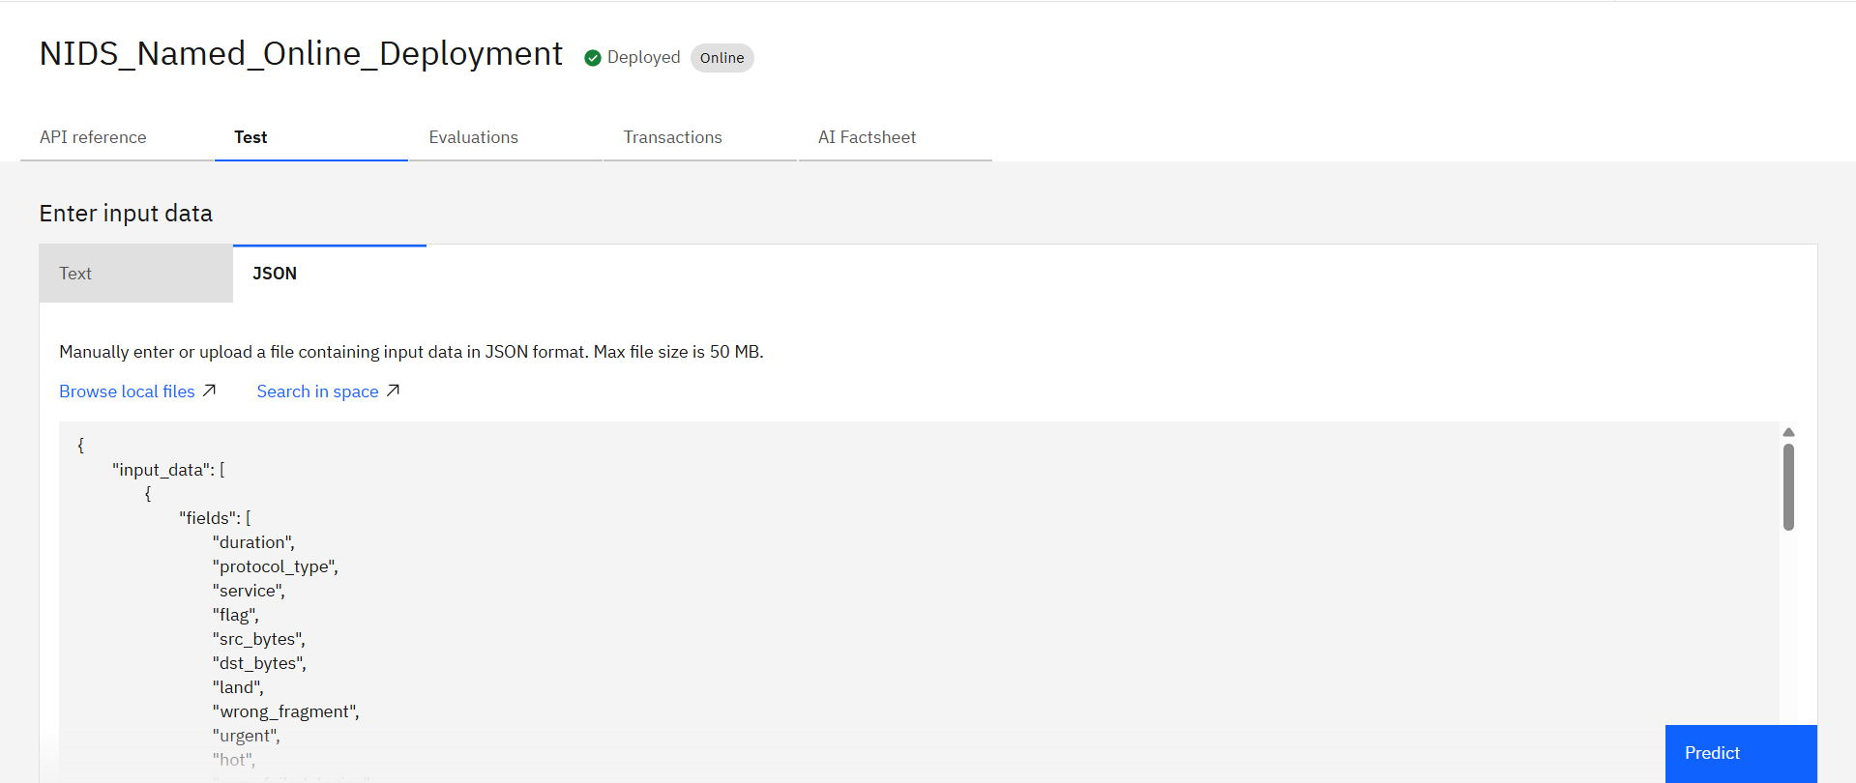
Deployment Status
The model has been successfully deployed as a live REST API endpoint on IBM Cloud, ready to accept real-time network traffic logs in JSON format for inference.

Slide 8
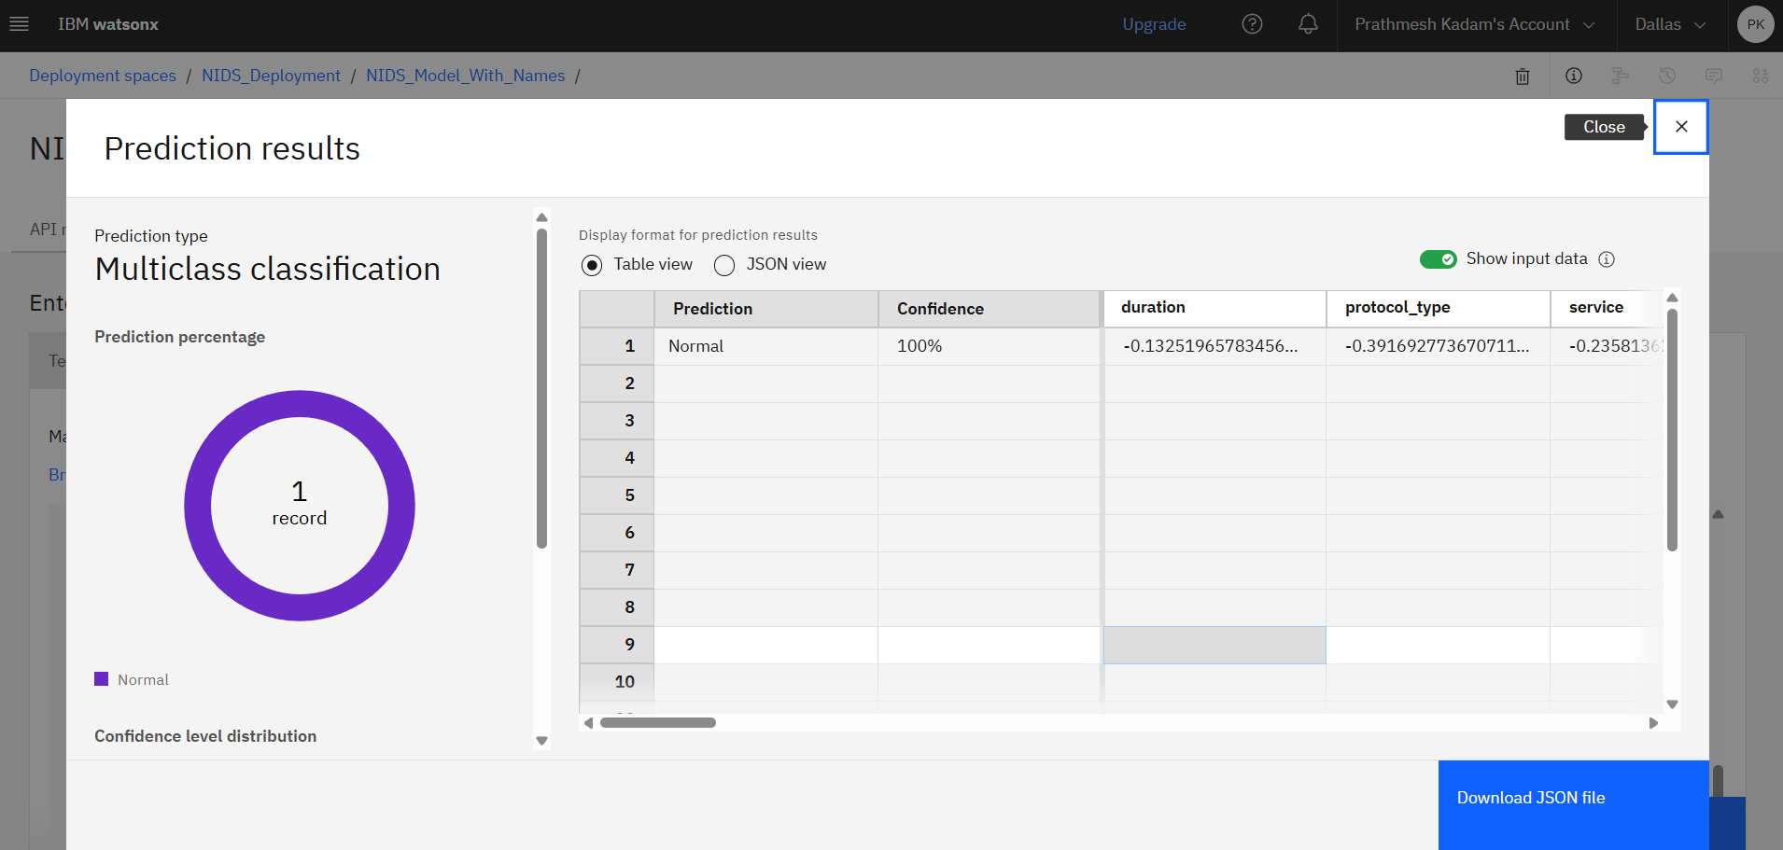
Testing and Evaluation
The deployed model undergoes rigorous testing. The prediction results demonstrate the multiclass classification output along with high confidence scores for incoming packet data.

Slide 9
Role of the Project
Automating Security Operations: The primary role is to automate the initial triage process typically handled by Level 1 SOC analysts, filtering out benign traffic instantly.
Enhancing Network Safety: Provides an early warning system that operates 24/7 without fatigue, flagging suspicious connections before they can compromise sensitive data.
Reducing Alert Fatigue: By utilizing high-accuracy machine learning, the system aims to significantly reduce false positive alerts compared to traditional, rigid firewall rules.
Bridging AI and Cybersecurity: Demonstrates the practical application of AI in modern enterprise infrastructure, showing how predictive models can secure digital perimeters.

Slide 10
Technology Details
Category | Technology Used | Purpose in Project
Cloud Platform | IBM Cloud Lite | Provides Platform as a Service (PaaS) for hosting the entire architecture without hardware management.
Machine Learning | IBM watsonx.ai | Used for end-to-end model lifecycle management (build, train, deploy, govern).
Data format | JSON (JavaScript Object Notation) | The lightweight data-interchange format used to pass packet features to the deployed endpoint.
Programming | Python (Scikit-Learn) | The core logic for defining the classification algorithms (e.g., Decision Trees).

Slide 11
Novelty and Uniqueness
Anomaly vs. Signature: Traditional firewalls rely on pre-written signatures (If-Then rules). This project's novelty lies in its ability to understand the mathematical relationship between network features, acting as an anomaly detector.
Zero-Day Threat Detection: Because the model learns what "normal" looks like, it can successfully flag newly invented cyber-attacks that have never been seen before (Zero-Day exploits), which bypass traditional rules.
Cloud-Native Deployment: Unlike legacy on-premise NIDS hardware, this solution is deployed completely on IBM Cloud, allowing it to scale instantly with network traffic volume.

Slide 12
Future Scope
IoT (Internet of Things) Integration: The model can be retrained on IoT-specific traffic datasets to secure smart homes, industrial sensors, and smart city infrastructure, which have different traffic profiles than standard computers.
Real-Time Stream Processing: Integrating tools like Apache Kafka to transition from batch prediction to high-throughput stream processing, handling millions of packets per second with sub-millisecond latency.
Hybrid Cloud Scaling: Expanding the deployment to a hybrid cloud architecture, allowing the detection engine to protect decentralized enterprise networks spanning across AWS, Azure, and on- premise servers.

Slide 13
GitHub Repository
The complete code, deployment configuration, and presentation files are hosted on GitHub.
GitHub link: https://github.com/Prathmeshk-web/IBM_NIDS

Slide 14
Thank You!
Thank you for your time and interest.

